Slide 1
Unit IV Decision Tree and Ensemble Model
Decision Tree and Random Forests; AdaBoost, Gradient Tree Boosting, Voting Classifier, k-Nearest neighbor classification; Applications of classifications; Concepts of Weak and eager learner, Ensembles of classifiers including bagging and boosting, Evaluation Matrices in classification.

Slide 2
Attribute Selection Measure: Information Gain (ID3/C4.5)
Select the attribute with the highest information gain
Let p_{i} be the probability that an arbitrary tuple in D belongs to class C_{i}, estimated by |C_{i, D}|/|D|
Expected information (entropy) needed to classify a tuple in D:
Information needed (after using A to split D into v partitions) to classify D:
Information gained by branching on attribute A
Notes:
I : the expected information needed to classify a given sample
E (entropy) : expected information based on the partitioning into subsets by A

Slide 3
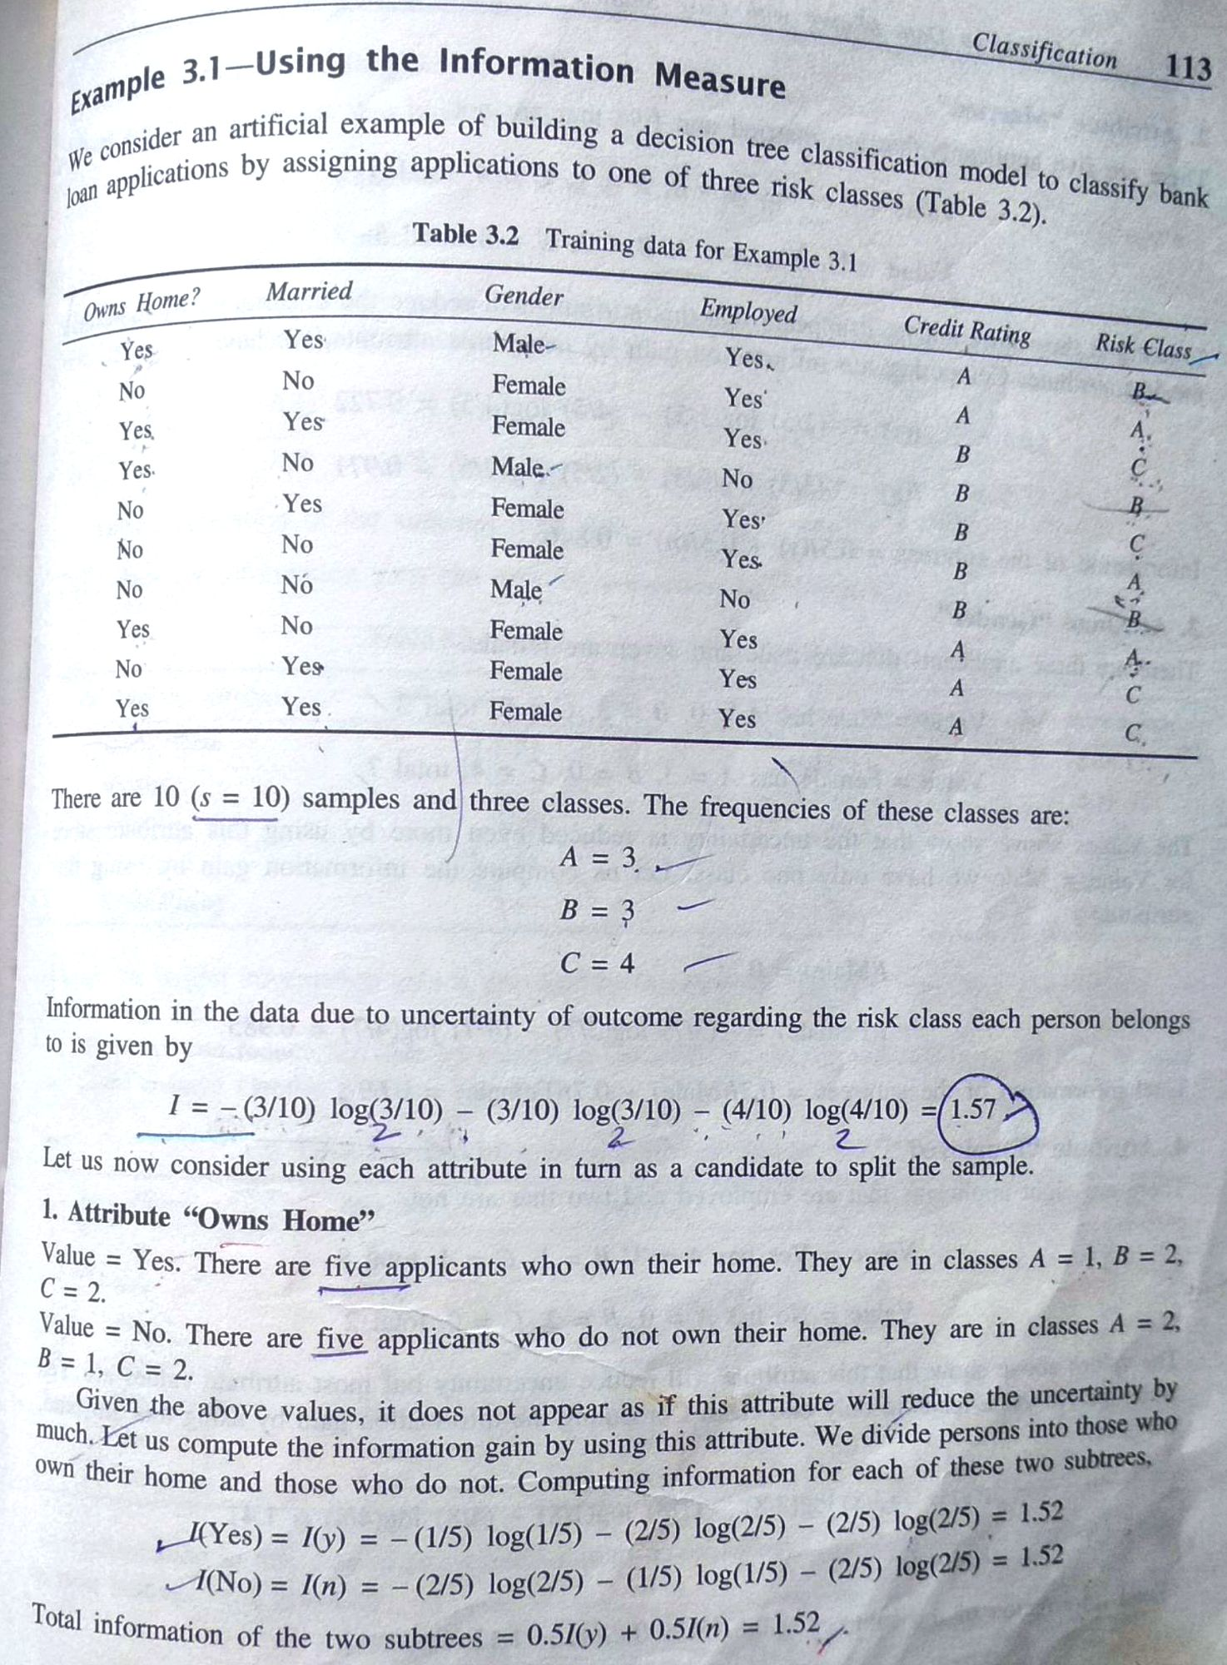

Slide 4
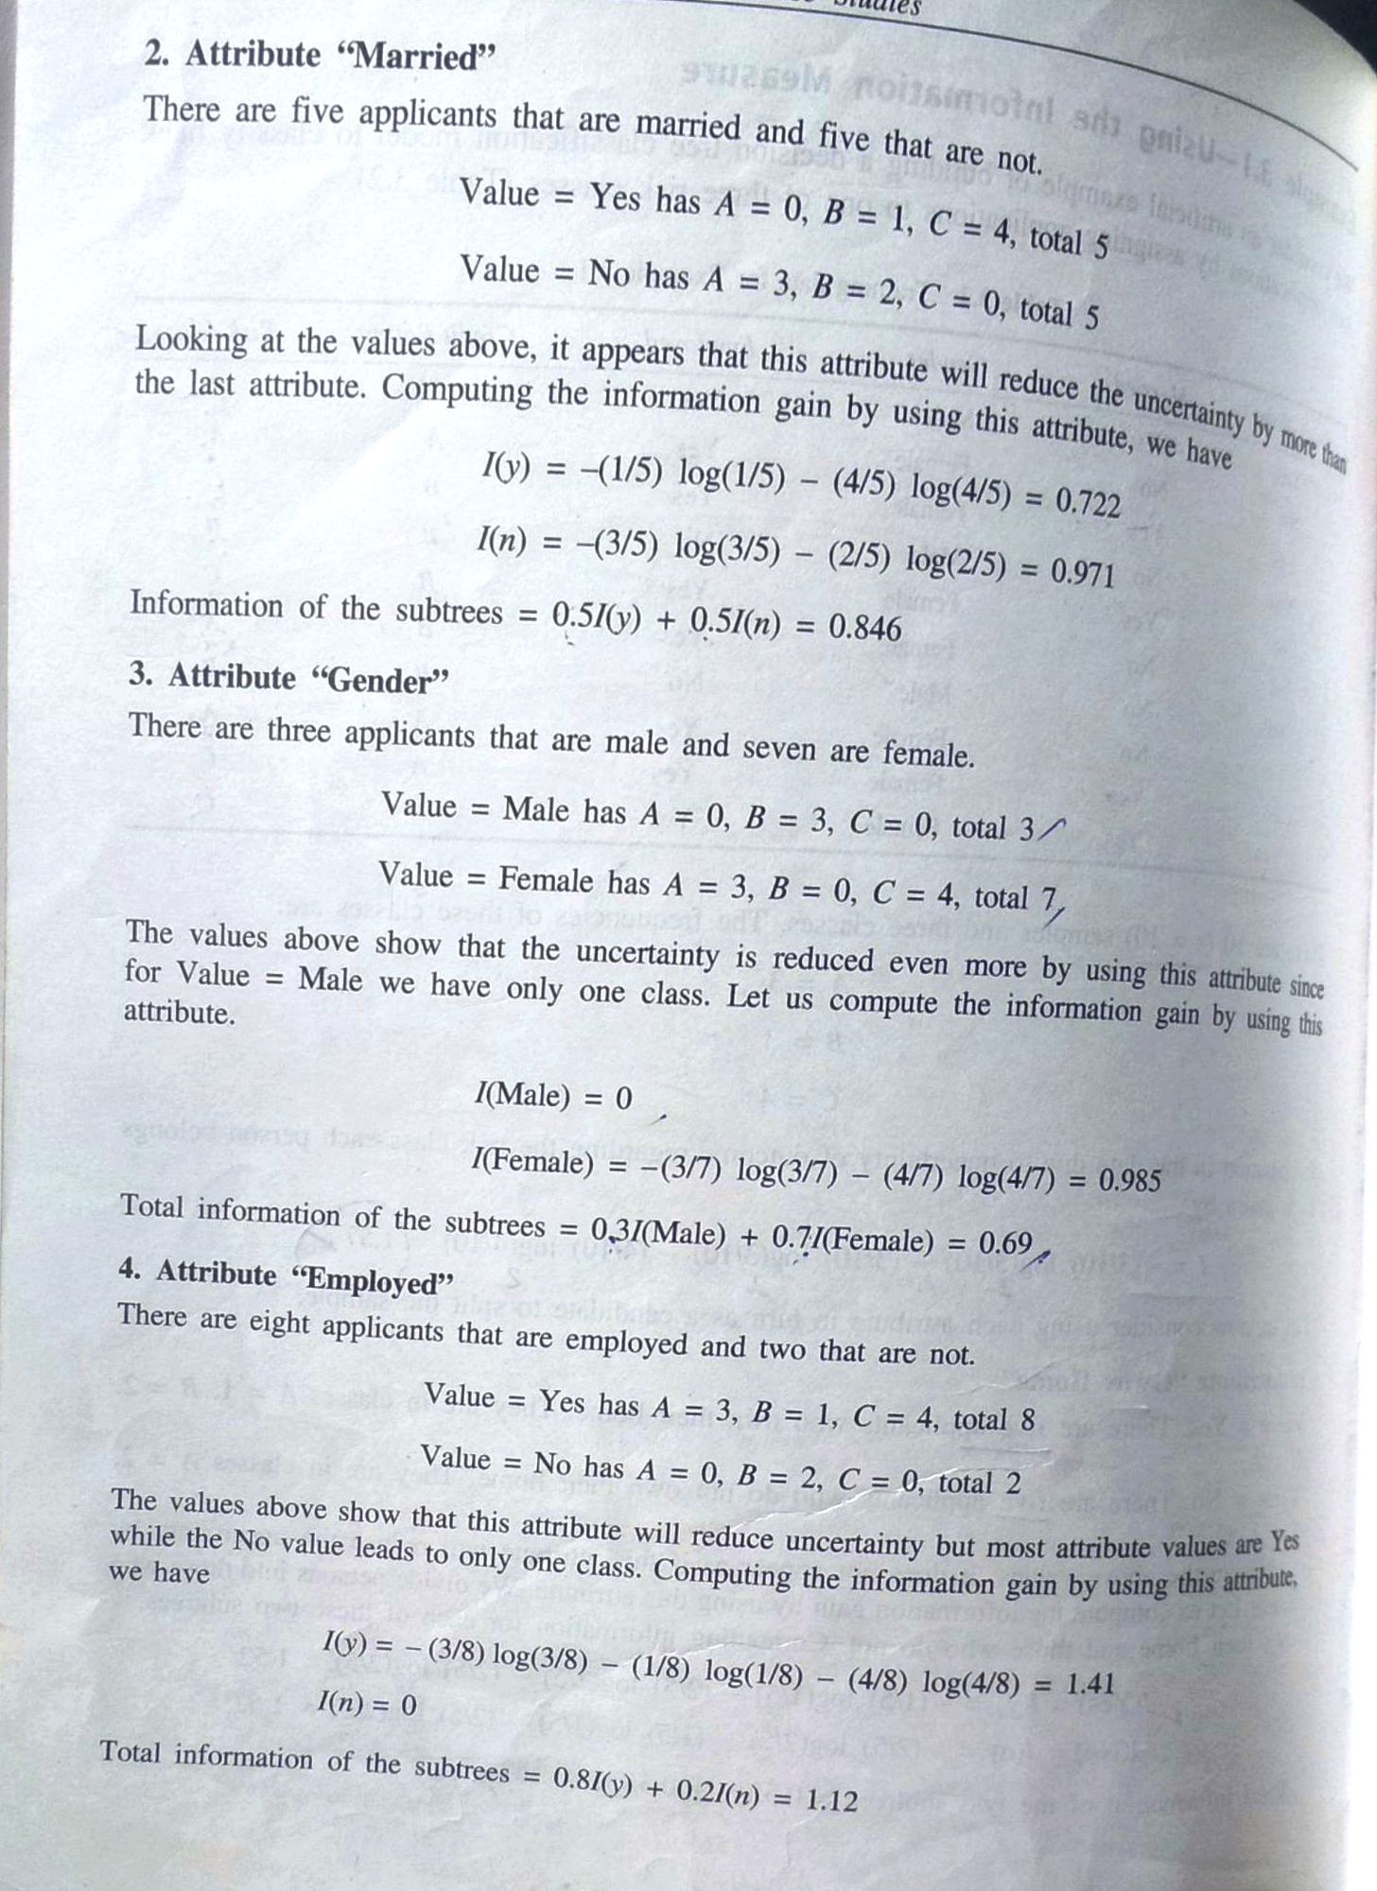

Slide 5
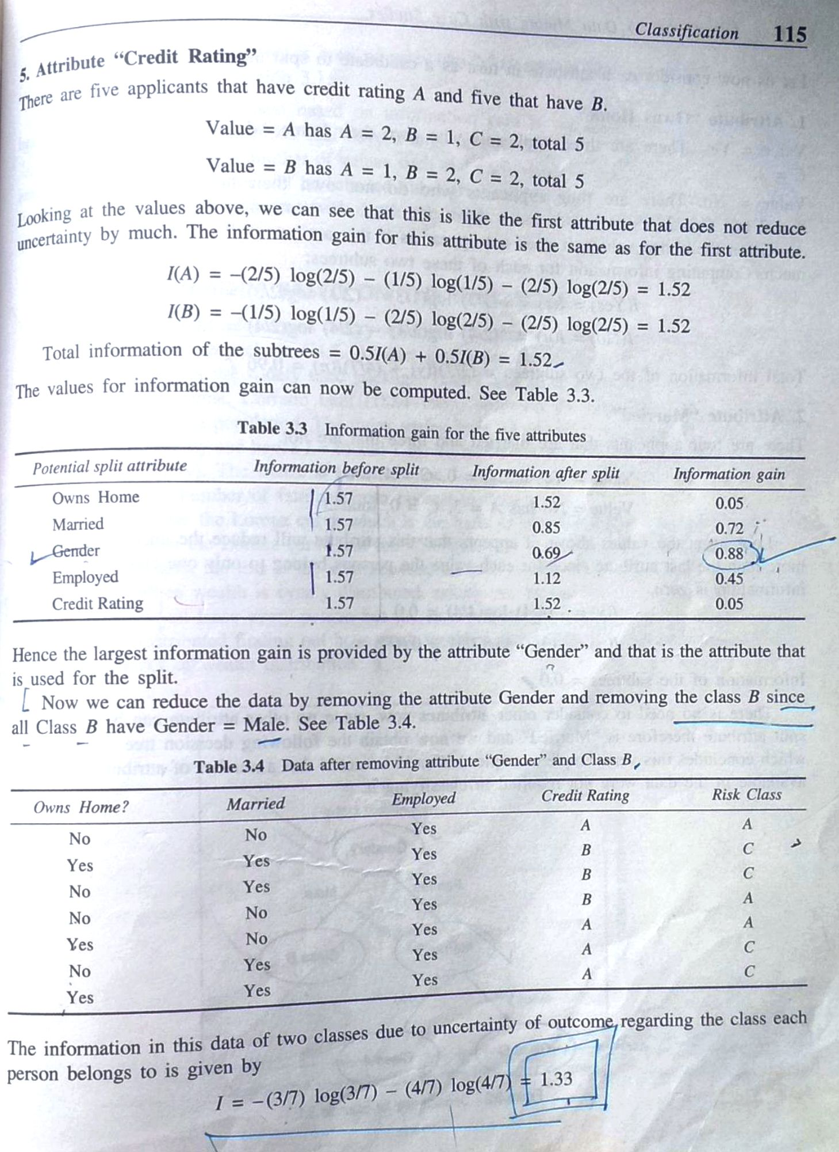

Slide 6
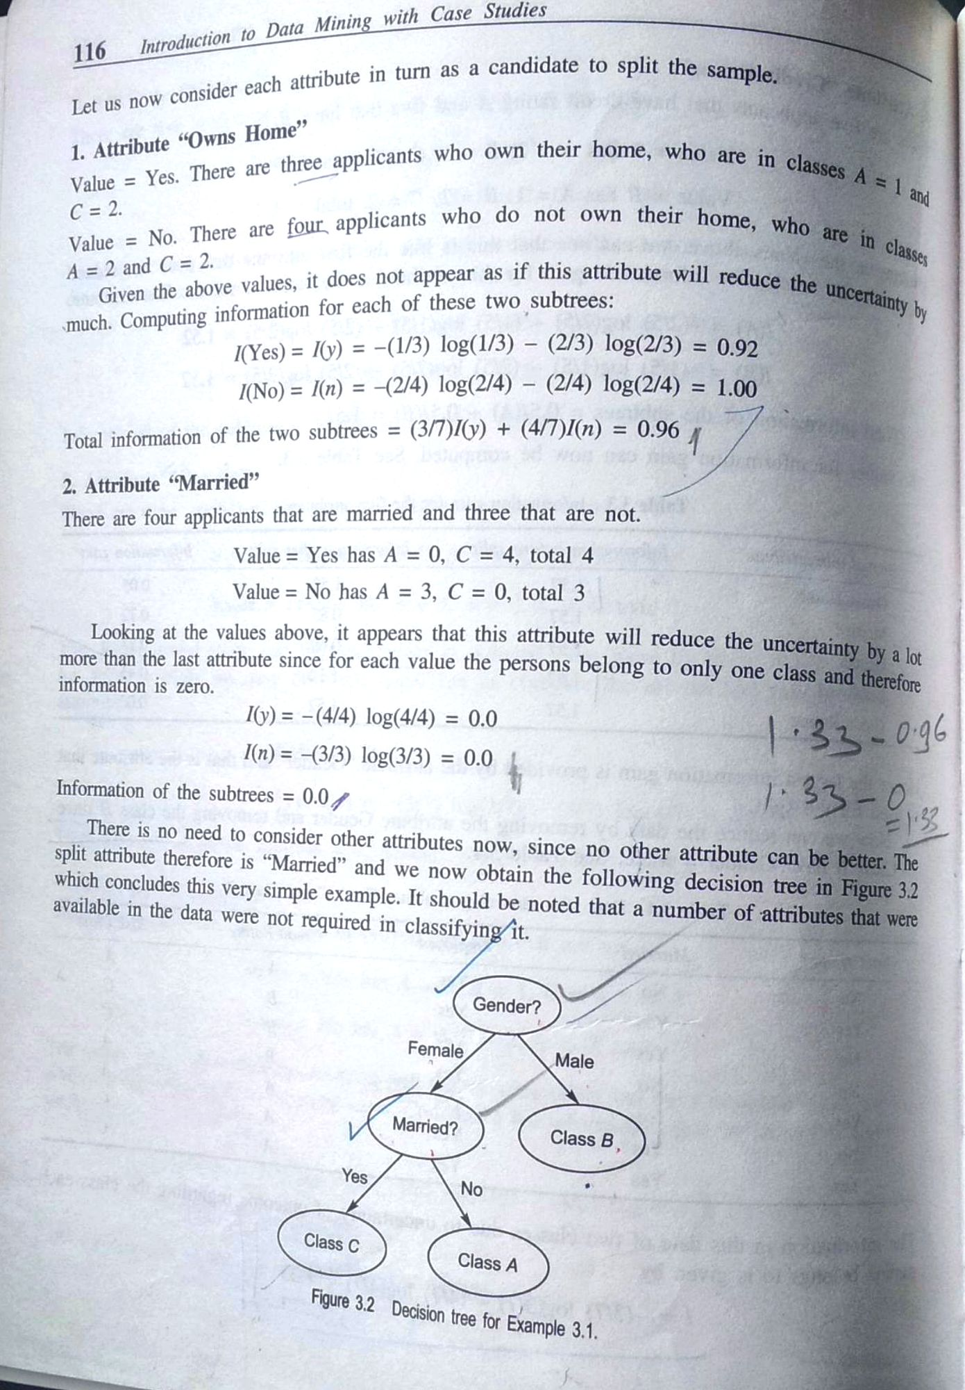

Slide 7
Attribute Selection: Information Gain
Class P: buys_computer = “yes”
Class N: buys_computer = “no”
means “age <=30” has 5 out of 14 samples, with 2 yes’es and 3 no’s. Hence
Similarly,

Slide 8
Computing Information-Gain for Continuous-Valued Attributes
Let attribute A be a continuous-valued attribute
Must determine the best split point for A
Sort the value A in increasing order
Typically, the midpoint between each pair of adjacent values is considered as a possible split point
(a_{i}+a_{i+1})/2 is the midpoint between the values of a_{i} and a_{i+1}
The point with the minimum expected information requirement for A is selected as the split-point for A
Split:
D1 is the set of tuples in D satisfying A ≤ split-point, and D2 is the set of tuples in D satisfying A > split-point

Slide 9
Gain Ratio for Attribute Selection (C4.5)
Information gain measure is biased towards attributes with a large number of values
C4.5 (a successor of ID3) uses gain ratio to overcome the problem (normalization to information gain)
GainRatio(A) = Gain(A)/SplitInfo(A)
Ex.
gain_ratio(income) = 0.029/1.557 = 0.019
The attribute with the maximum gain ratio is selected as the splitting attribute

Slide 10
Gini Index (CART, IBM IntelligentMiner)
If a data set D contains examples from n classes, gini index, gini(D) is defined as
where p_{j} is the relative frequency of class j in D
If a data set D is split on A into two subsets D₁ and D₂, the gini index gini(D) is defined as
Reduction in Impurity:
The attribute provides the smallest gini_{split}(D) (or the largest reduction in impurity) is chosen to split the node (need to enumerate all the possible splitting points for each attribute)

Slide 11
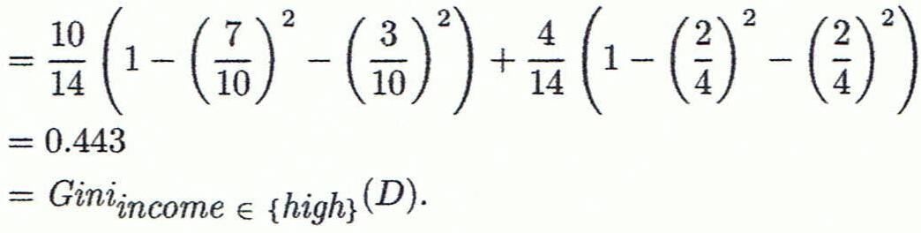
Computation of Gini Index
Ex. D has 9 tuples in buys_computer = “yes” and 5 in “no”
Suppose the attribute income partitions D into 10 in D₁: {low, medium} and 4 in D₂
Gini_{{low,high}} is 0.458; Gini_{{medium,high}} is 0.450. Thus, split on the {low,medium} (and {high}) since it has the lowest Gini index
All attributes are assumed continuous-valued
May need other tools, e.g., clustering, to get the possible split values
Can be modified for categorical attributes

Slide 12
Comparing Attribute Selection Measures
The three measures, in general, return good results but
Information gain:
biased towards multivalued attributes
Gain ratio:
tends to prefer unbalanced splits in which one partition is much smaller than the others
Gini index:
biased to multivalued attributes
has difficulty when # of classes is large
tends to favor tests that result in equal-sized partitions and purity in both partitions

Slide 13
Classifier Evaluation Metrics: Confusion Matrix
Confusion Matrix:
Actual class\Predicted class | C₁ | ¬ C₁
C₁ | True Positives (TP) | False Negatives (FN)
¬ C₁ | False Positives (FP) | True Negatives (TN)
Example of Confusion Matrix:
Actual class\Predicted class | buy_computer = yes | buy_computer = no | Total
buy_computer = yes | 6954 | 46 | 7000
buy_computer = no | 412 | 2588 | 3000
Total | 7366 | 2634 | 10000
Given m classes, an entry, CM_{i,j} in a confusion matrix indicates # of tuples in class i that were labeled by the classifier as class j
May have extra rows/columns to provide totals
13

Slide 14
Classifier Evaluation Metrics: Accuracy, Error Rate, Sensitivity and Specificity
A\P | C | ¬C
C | TP | FN | P
¬C | FP | TN | N
 | P’ | N’ | All
Class Imbalance Problem:
One class may be rare, e.g. fraud, or HIV-positive
Significant majority of the negative class and minority of the positive class
Sensitivity: True Positive recognition rate
Sensitivity = TP/P
Specificity: True Negative recognition rate
Specificity = TN/N
Classifier Accuracy, or recognition rate: percentage of test set tuples that are correctly classified
Accuracy = (TP + TN)/All
Error rate: 1 – accuracy, or
Error rate = (FP + FN)/All
14

Slide 15
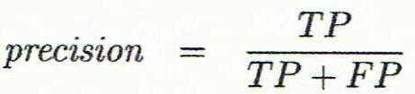
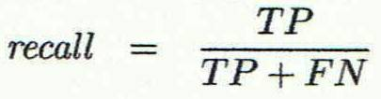
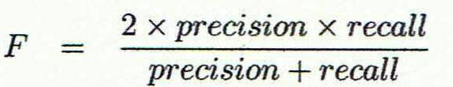
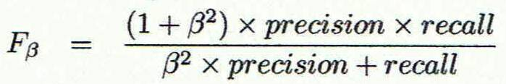
Classifier Evaluation Metrics: Precision and Recall, and F-measures
Precision: exactness – what % of tuples that the classifier labeled as positive are actually positive
Recall: completeness – what % of positive tuples did the classifier label as positive?
Perfect score is 1.0
Inverse relationship between precision & recall
F measure (F₁ or F-score): harmonic mean of precision and recall,
F_{ß}: weighted measure of precision and recall
assigns ß times as much weight to recall as to precision
15

Slide 16
Classifier Evaluation Metrics: Example
Actual Class\Predicted class | cancer = yes | cancer = no | Total | Recognition(%)
cancer = yes | 90 | 210 | 300 | 30.00 (sensitivity
cancer = no | 140 | 9560 | 9700 | 98.56 (specificity)
Total | 230 | 9770 | 10000 | 96.40 (accuracy)
Precision = 90/230 = 39.13% Recall = 90/300 = 30.00%
16

Slide 17
Evaluating Classifier Accuracy: Holdout & Cross-Validation Methods
Holdout method
Given data is randomly partitioned into two independent sets
Training set (e.g., 2/3) for model construction
Test set (e.g., 1/3) for accuracy estimation
Random sampling: a variation of holdout
Repeat holdout k times, accuracy = avg. of the accuracies obtained
Cross-validation (k-fold, where k = 10 is most popular)
Randomly partition the data into k mutually exclusive subsets, each approximately equal size
At i-th iteration, use D_{i} as test set and others as training set
Leave-one-out: k folds where k = # of tuples, for small sized data
*Stratified cross-validation*: folds are stratified so that class dist. in each fold is approx. the same as that in the initial data
17

Slide 18
Model Selection: ROC Curves
ROC (Receiver Operating Characteristics) curves: for visual comparison of classification models
Originated from signal detection theory
Shows the trade-off between the true positive rate and the false positive rate
The area under the ROC curve is a measure of the accuracy of the model
Rank the test tuples in decreasing order: the one that is most likely to belong to the positive class appears at the top of the list
The closer to the diagonal line (i.e., the closer the area is to 0.5), the less accurate is the model
Vertical axis represents the true positive rate
Horizontal axis rep. the false positive rate
The plot also shows a diagonal line
A model with perfect accuracy will have an area of 1.0
18

Slide 19
Issues Affecting Model Selection
Accuracy
classifier accuracy: predicting class label
Speed
time to construct the model (training time)
time to use the model (classification/prediction time)
Robustness: handling noise and missing values
Scalability: efficiency in disk-resident databases
Interpretability
understanding and insight provided by the model
Other measures, e.g., goodness of rules, such as decision tree size or compactness of classification rules
19
Notes:
19

Slide 20
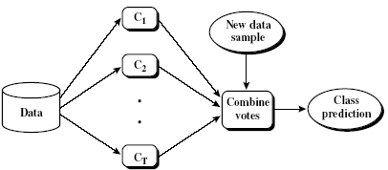
Ensemble Methods: Increasing the Accuracy
Ensemble methods
Use a combination of models to increase accuracy
Combine a series of k learned models, M₁, M₂, …, M_{k}, with the aim of creating an improved model M*
Popular ensemble methods
Bagging: averaging the prediction over a collection of classifiers
Boosting: weighted vote with a collection of classifiers
Ensemble: combining a set of heterogeneous classifiers
20

Slide 21
Bagging: Boostrap Aggregation
Analogy: Diagnosis based on multiple doctors’ majority vote
Training
Given a set D of d tuples, at each iteration i, a training set D_{i} of d tuples is sampled with replacement from D (i.e., bootstrap)
A classifier model M_{i} is learned for each training set D_{i}
Classification: classify an unknown sample X
Each classifier M_{i} returns its class prediction
The bagged classifier M* counts the votes and assigns the class with the most votes to X
Prediction: can be applied to the prediction of continuous values by taking the average value of each prediction for a given test tuple
Accuracy
Often significantly better than a single classifier derived from D
For noise data: not considerably worse, more robust
Proved improved accuracy in prediction
21

Slide 22
Boosting
Analogy: Consult several doctors, based on a combination of weighted diagnoses—weight assigned based on the previous diagnosis accuracy
How boosting works?
Weights are assigned to each training tuple
A series of k classifiers is iteratively learned
After a classifier M_{i} is learned, the weights are updated to allow the subsequent classifier, M_{i+1}, to pay more attention to the training tuples that were misclassified by M_{i}
The final M* combines the votes of each individual classifier, where the weight of each classifier's vote is a function of its accuracy
Boosting algorithm can be extended for numeric prediction
Comparing with bagging: Boosting tends to have greater accuracy, but it also risks overfitting the model to misclassified data
22

Slide 23
Adaboost
Given a set of d class-labeled tuples, (X₁, y₁), …, (X_{d}, y_{d})
Initially, all the weights of tuples are set the same (1/d)
Generate k classifiers in k rounds. At round i,
Tuples from D are sampled (with replacement) to form a training set D_{i} of the same size
Each tuple’s chance of being selected is based on its weight
A classification model M_{i} is derived from D_{i}
Its error rate is calculated using D_{i} as a test set
If a tuple is misclassified, its weight is increased, o.w. it is decreased
Error rate: err(X_{j}) is the misclassification error of tuple X_{j}. Classifier M_{i} error rate is the sum of the weights of the misclassified tuples:
The weight of classifier M_{i}’s vote is

Slide 24
Random Forest (Breiman 2001)
Random Forest:
Each classifier in the ensemble is a decision tree classifier and is generated using a random selection of attributes at each node to determine the split
During classification, each tree votes and the most popular class is returned
Two Methods to construct Random Forest:
Forest-RI (random input selection): Randomly select, at each node, F attributes as candidates for the split at the node. The CART methodology is used to grow the trees to maximum size
Forest-RC (random linear combinations): Creates new attributes (or features) that are a linear combination of the existing attributes (reduces the correlation between individual classifiers)
Comparable in accuracy to Adaboost, but more robust to errors and outliers
Insensitive to the number of attributes selected for consideration at each split, and faster than bagging or boosting
24

Slide 25
Classification of Class-Imbalanced Data Sets
Class-imbalance problem: Rare positive example but numerous negative ones, e.g., medical diagnosis, fraud, oil-spill, fault, etc.
Traditional methods assume a balanced distribution of classes and equal error costs: not suitable for class-imbalanced data
Typical methods for imbalance data in 2-class classification:
Oversampling: re-sampling of data from positive class
Under-sampling: randomly eliminate tuples from negative class
Threshold-moving: moves the decision threshold, t, so that the rare class tuples are easier to classify, and hence, less chance of costly false negative errors
Ensemble techniques: Ensemble multiple classifiers introduced above
Still difficult for class imbalance problem on multiclass tasks
25

Slide 26
Issues: Evaluating Classification Methods
Accuracy
classifier accuracy: predicting class label
predictor accuracy: guessing value of predicted attributes
Speed
time to construct the model (training time)
time to use the model (classification/prediction time)
Robustness: handling noise and missing values
Scalability: efficiency in disk-resident databases
Interpretability
understanding and insight provided by the model
Other measures, e.g., goodness of rules, such as decision tree size or compactness of classification rules
26
Notes:
26

